Slide 1
Collaboration platform, AllAgeHub
VISION
Research, development and innovation that promotes accessible housing and assistive technology services, so that all people can live independent and safe lives regardless of disability or age.
Development phase: 2017-2019
www.allagehub.se

Slide 2
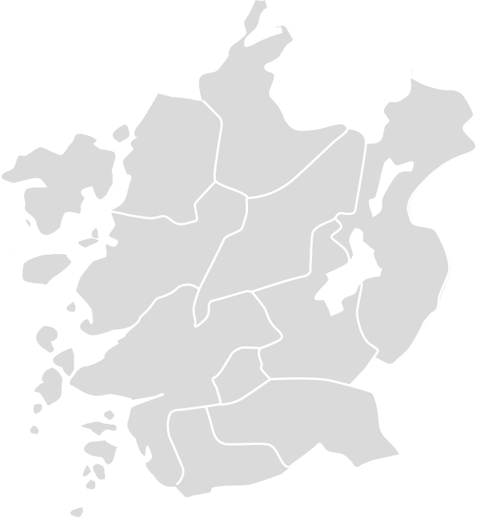
A joint initiative launched by twelve municipalities
Ale
Alingsås
Göteborg
Härryda
Kungälv
Lerum
Lilla Edet
Mölndal
Partille
Stenungsund
Tjörn
Öckerö
with the Göteborg Region Association of Local Authorities acting as the project owner, 2017-2019.

Slide 3
What AllAgeHub do
Products and services do not always correspond to users needs. We identify and fill the gap between what society provides and what people actually need.
Ale
Alingsås
Göteborg
Härryda
Kungälv
Lerum
Lilla Edet
Mölndal
Partille
Stenungsund
Tjörn
Öckerö
We enable companies to develop products and services in collaboration with their target group.
We have a new approach to successfully meet the future needs of healthcare and social care services for people regardless of disability or age.
We leverage existing knowledge and develop new knowledge regarding assistive technology and accessible housing.
We support twelve municipalities with implementing assistive technology.

Slide 4
Collaborators
Public sector
Göteborgsregionens kommunalförbund, GR (Projektägare under etableringsfasen)
Twelve municipalities: Ale, Alingsås, Göteborg, Härryda, Kungälv, Lerum, Lilla Edet, Mölndal, Partille, Stenungsund, Tjörn och Öckerö.
Västra Götalandsregionen, Koncernstab Hälso- och sjukvård, avdelning Vårdens digitalisering och DART.
Business world
Pensionärernas riksorganisation, PRO
Sveriges Pensionärsförbund, SPF Seniorerna
Academia
Fastighetskoncernen Framtiden AB
Johanneberg Science Park
Sahlgrenska Science Park.
Business region Göteborg
Civil society
AgeCap, Göteborgs Universitet
Centrum för personcentrerad vård, GPCC, Göteborgs Universitet
Centrum för vårdens arkitektur, CVA, Chalmers
Building futures, Chalmers
Centrum för välfärdsstudier, CVS, Högskolan i Borås
Financiers:
Twelve municipalities
Vinnova
Västra Götalandsregionen, Regionutvecklingsnämnden

Slide 5
AllAgeHub
Interactive environment
The starting point of everything we do is to solve the challenges identified by users and municipalities.
Ale Alingsås Göteborg Härryda Kungälv Lerum Lilla Edet Mölndal Partille Stenungsund Tjörn Öckerö
Market intelligence
Market intelligence
Public sector
Learning
Business world
Challenges
Academia
Research
Four perspectives.
Twelve municipalities in cooperation.
Civil society
Market intelligence
Market intelligence
Market intelligence.
Innovation

